Slide 1
Ethics in Information Technology
Chapter 2
Ethics for IT Workers and IT Users
George W. Reynolds

Slide 2
Learning Objectives
What relationships must an IT worker manage, and what key ethical issues can arise in each?
What can be done to encourage the professionalism of IT workers?
What ethical issues do IT users face, and what can be done to encourage their ethical behavior?

Slide 3
IT Worker Relationships That Must be Managed
Employers
Clients
Suppliers
Other professionals
IT users
Society at large

Slide 4
Relationships Between IT Workers and Employers
Key issues:
Setting and enforcing policies regarding the ethical use of IT
The safeguarding of trade secrets
The potential for whistle-blowing

Slide 5
Ethical Use of IT
IT staff may actively engage in software piracy or allow it to happen—often to reduce IT-related spending.
Trade groups representing the world’s largest IT companies are focused on stopping software piracy:
Software & Information Industry Association (SIIA)
Promotes the common interests of the software and digital content industries
BSA | The Software Alliance (BSA)
Funded through member companies’ dues and through settlements from companies that commit piracy

Slide 6
Trade Secrets & Whistle-Blowing
Trade secret: Information that a company has taken strong measures to keep confidential
Companies may require employees to sign confidentiality agreements promising not to reveal trade secrets.
Whistle-blowing: An effort by an employee to attract attention to an act by a company that threatens the public interest
Whistle-blowers often have special information based on their expertise or position.

Slide 7
Relationships Between IT Workers and Clients
Key issues:
Conflict of interest: A conflict between the IT worker’s (or the IT firm’s) self-interest and the client’s interests
Fraud: The crime of obtaining goods, services, or property through deception or trickery
Misrepresentation: The misstatement or incomplete statement of a material fact
Breach of contract: Occurs when one party fails to meet the terms of a contract
Material breach of contract: Occurs when a party fails to perform certain obligations, thus, impairing or destroying the essence of the contract

Slide 8
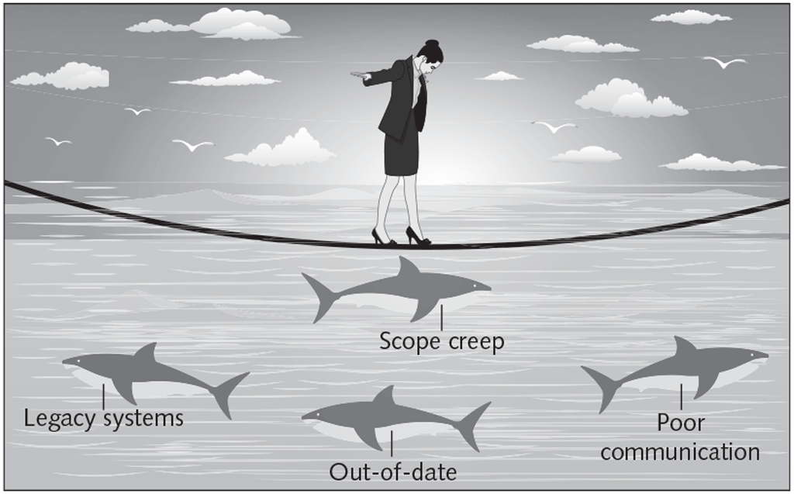
Frequent Causes of Problems in IT Projects

Slide 9
Relationships Between IT Workers and Suppliers
Key issues:
Bribery: The act of providing money, property, or favors to obtain a business advantage
Internal control: The process established to provide reasonable assurance for the effectiveness and efficiency of operations, the reliability of financial reporting, and compliance with applicable laws and regulations
Separation of duties: The act of ensuring that different aspects of processes involving financial transactions are handled by different people

Slide 10
Foreign Corrupt Practices Act (FCPA)
Foreign Corrupt Practices Act (FCPA): Makes it a crime to bribe a foreign official, a foreign political party official, or a candidate for foreign political office
Applies to any U.S. citizen or company and to any company with shares listed on any U.S. stock exchange
FCPA penalties:
Corporations: A fine of up to $2 million per violation
Individuals: A fine of up to $100,000 and a 5-year prison term

Slide 11
Distinguishing Between Bribes and Gifts
Bribes | Gifts
Made in secret, as they are neither legally nor morally acceptable | Made openly and publicly, as a gesture of friendship or goodwill
Often made indirectly through a third party | Made directly from donor to recipient
Encourage an obligation for the recipient to act favorably toward the donor | Come with no expectation of a future favor for the donor

Slide 12
Relationships Between IT Workers and Other Professionals
Key issues:
Professionals owe each other an adherence to their profession’s code of conduct
Résumé inflation: Lying on a résumé about one’s qualifications
Inappropriate sharing of corporate information, which may be sold or shared informally with third parties

Slide 13
Relationships Between IT Workers and Society
Key issues:
Society expects members of a profession to:
Provide significant benefits
Not cause harm through their actions
Professional organizations provide codes of ethics to guide IT workers’ actions

Slide 14
Encouraging the Professionalism of IT Workers
Characteristics of professionals:
Have expertise in the tools and skills needed to do their job
Adhere to high ethical and moral standards
Produce high-quality results
Meet their commitments
Communicate effectively
Train and develop others with less experience

Slide 15
Improving IT Workers’ Reputation for Professionalism
IT can workers can improve their profession’s reputation for professionalism by:
Subscribing to a professional code of ethics
Joining and participating in professional organizations
Obtaining appropriate certifications
Supporting government licensing where available

Slide 16
Professional Code of Ethics
Professional code of ethics: A statement of the principles and core values that are essential to the work of a particular occupational group
A professional code of ethics produces benefits for the individual, the profession, and society as a whole:
Ethical decision making
High standards of practice and ethical behavior
Trust and respect from the general public
Evaluation benchmarks

Slide 17
Professional Organizations
Help IT workers network with others, seek out new ideas, and build on their personal skills and expertise
Prominent IT-related organizations:
Association for Computing Machinery (ACM)
Institute of Electrical and Electronics Engineers Computer Society (IEEE-CS)
Association of Information Technology Professionals (AITP)
SysAdmin, Audit, Network, Security (SANS) Institute

Slide 18
Certification
Certification: A recognition that a professional possesses a particular set of skills, knowledge, or abilities, in the opinion of the certifying organization
Obliges an individual to have the prerequisite education and experience, and to pass an exam
Certifications from industry associations require a higher level of experience and a broader perspective than vendor certifications
IT-related certifications may or may not include a requirement to adhere to a code of ethics

Slide 19
Licensing of IT Professionals
Government license: Permission to engage in an activity or to operate a business
The case for licensing IT workers:
Improve information systems
Encourage IT workers to follow the highest standards of the profession and practice a code of ethics
Without licensing: No well-defined requirements for heightened care and no concept of professional malpractice
State licensing boards have authority over the specific requirements for licensing in their jurisdiction

Slide 20
Joint Steering Committee for the Establishment of Software Engineering as a Profession
Joint committee of the ACM and IEEE-CS
Initial recommendations:
Define ethical standards
Define the required body of knowledge and recommended practices in software engineering
Body of knowledge: For a given profession—outlines an agreed-upon set of skills and abilities that all licensed professionals must possess
Define appropriate curricula to acquire knowledge

Slide 21
Potential Legal Issues Related to Licensing IT Workers
Negligence: Not doing something that a reasonable person would do or doing something that a reasonable person would not do
Duty of care: The obligation to protect people against unreasonable harm or risk
Reasonable person standard: A standard used by courts to evaluate how an objective, careful, and conscientious person would have acted in the same circumstances
Reasonable professional standard: Used to measure the actions of professionals who have particular expertise or competence

Slide 22
IT Professional Malpractice
Breach of the duty of care: The failure to act as a reasonable person would act
Professional malpractice: The liability of professionals who breach the duty of care, resulting in negligent care and injuries
Professional negligence can only occur if there are uniform standards against which to compare their professional behavior.

Slide 23
Common Ethical Issues for IT Users
Software piracy
Has a negative impact on future software development
Android operating system has contributed to the software piracy problem
Inappropriate use of computing resources
Erodes worker productivity and wastes time
Could lead to workplace racial/sexual harassment lawsuits
Inappropriate sharing of information
Private personal data: Privacy violation
Confidential company data: Could fall into the hands of competitors

Slide 24
Supporting the Ethical Practices of IT Users
Establish guidelines for the use of company hardware and software
Define an acceptable use policy (AUP)
Structure information systems to protect data and information
Install and maintain a company firewall
Firewall: Hardware or software that serves as the first line of defense between an organization’s network and the Internet; also limits access to the company’s network based on an Internet-usage policy
Compliance

Slide 25
Acceptable Use Policy (AUP)
AUP: Stipulates restrictions and practices that a user must agree to in order to use organizational computing and network resources
An effective AUP contains five elements:
Purpose
Scope
Policy
Compliance
Sanctions
An organization’s information security (infosec) group is responsible for monitoring compliance to the AUP

Slide 26
Manager’s Checklist For Establishing an Acceptable Use Policy, Part 1
QUESTION | YES | NO
Is there a statement that explains the need for an acceptable use policy? Is it clear how the policy applies to the following types of workers? Full-time employees Part-time employees Temps Contractors Does the policy address the following issues? Protection of the data privacy rights of employees, customers, suppliers, and others Control of access to proprietary company data and information Use of unauthorized or pirated software

Slide 27
Manager’s Checklist For Establishing an Acceptable Use Policy, Part 2
QUESTION | YES | NO
Does the policy address the following issues? (continued) Employee monitoring, including email, wiretapping and eavesdropping on phone conversations, computer monitoring, and surveillance by video Respect of the intellectual rights of others, including trade secrets, copyrights, patents, and trademarks Inappropriate use of IT resources, such as web surfing, excessive use of social networks, blogging, personal emailing, and other use of computers for purposes other than business The need to protect the security of IT resources through adherence to good security practices, such as not sharing user IDs and passwords, using hard-to-guess passwords, and frequently changing passwords

Slide 28
Manager’s Checklist For Establishing an Acceptable Use Policy, Part 3
QUESTION | YES | NO
Does the policy address the following issues? (continued) The use of the computer to intimidate, harass, or insult others through abusive language in emails and by other means Are disciplinary actions defined for IT-related abuses? Is there a process for communicating the policy to employees? Is there a plan to provide effective, ongoing training relative to the policy?

Slide 29
Compliance
Compliance: To be in accordance with established policies, guidelines, specifications, or legislation
Failure to be in compliance with legislation can lead to lawsuits or government fines.
Demonstrating compliance with multiple government and industry regulations can be challenging.

Slide 30
Audit Committee
Provides assistance to the board of directors with respect to:
Quality and integrity of accounting and reporting practices and controls
Compliance with legal and regulatory requirements
Qualifications, independence, and performance of the organization’s independent auditor
Performance of the company’s internal audit team

Slide 31
Internal Audit Department
Primary responsibilities:
Determine that internal systems and controls are effective
Verify existence of company assets and maintain proper safeguards over their protection
Measure organization’s compliance with its own policies and procedures
Ensure that institutional policies and procedures, appropriate laws, and good practices are followed
Evaluate adequacy and reliability of information available for management decision making

Slide 32
Summary, Part 1
What relationships must an IT worker manage, and what key ethical issues can arise in each?
IT workers and employers:
Setting policies regarding the ethical use of IT, safeguarding trade secrets, and whistle-blowing
IT workers and clients:
Defining and fulfilling each party’s responsibilities for successfully completing an IT project
IT workers and suppliers:
Developing working relationships in which no action can be perceived as unethical
Internal control: Assures effectiveness of operations, reliability of financial reporting and compliance; separation of duties

Slide 33
Summary, Part 2
What relationships must an IT worker manage, and what key ethical issues can arise in each?
IT workers and other professionals:
Mentoring inexperienced colleagues, demonstrating professional loyalty, avoiding résumé inflation, and preventing inappropriate sharing of information
IT workers and IT users:
Software piracy, inappropriate use of IT resources, and inappropriate sharing of information
IT workers and society at large:
Practicing the profession in ways that cause no harm and provide benefits to society

Slide 34
Summary, Part 3
What can be done to encourage the professionalism of IT workers?
Professionals:
Possess the skills, good judgment, and work habits expected from a person who has the training and experience to do a job well
Contribute to society, participate in lifelong training, and help develop other professionals
IT workers can improve their profession’s reputation for professionalism:
Subscribe to a professional code of ethics
Join professional organizations
Obtain appropriate certifications
Support government licensing

Slide 35
Summary, Part 4
What can be done to encourage the professionalism of IT workers?
Professional code of ethics: States the principles and core values essential to the work of a particular occupational group
Benefits of a code of ethics: Ethical decision making, high standards of ethical behavior, trust and respect with the general public, and access to an evaluation benchmark for self-assessment
IT-related professional organizations with a code of ethics:
ACM, IEEE-CS, AITP, and SANS

Slide 36
Summary, Part 5
What can be done to encourage the professionalism of IT workers?
Certification and licensing of IT workers:
Proponents argue that certification and licensing would increase the reliability and effectiveness of information systems.
Certification indicates a professional possesses a particular set of skills, knowledge, or abilities, in the opinion of the certifying organization.
Most states support the licensing of software engineers.
State licensing boards have responsibility over specific requirements in their jurisdiction.

Slide 37
Summary, Part 6
What ethical issues do IT users face, and what can be done to encourage their ethical behavior?
Ethical issues faced by IT users: Software piracy, inappropriate use of computing resources, and inappropriate sharing of data
Actions to encourage ethical behavior: Establish guidelines for the use of technology, define an AUP; structure information systems to protect data, maintain a firewall, and ensure compliance
The audit committee of a board of directors and the internal audit team: Ensure that the IT organization and IT users are in compliance with organizational policies, laws, and regulations

